Slide 1
T
HE THINKING ORGANIZATION
WORKSHOP SERIES
Presentation & Dialogue

Slide 2
Today’s Proposed Agenda
Purpose for the Meeting
Develop understanding of The Thinking Organization Workshop (TTOS)
Intended Results
Listening/Speaking Level comprehension of TTOS:
Underlying rationale
Track record
Content
Methods
Sample thinking framework/tool
Process
Review and upgrade this meeting agenda
Background & Rationale behind the content and methodology
Overview of “The Thinking Organization Workshop Series” content and methods
Sample thinking framework/tool and thinking scales/measurements for managing thinking processes

Slide 3
Why Focus on Developing Thinking Capability?
“Future Trends in Leadership Development”, a 2014 white paper by Nick Petrie of the Center for Creative Leadership. summarized a year-long sabbatical at Harvard studying the work of dozens of leading researchers, educators and experts from Harvard, other universities, consulting firms, corporate universities as:
The new world presents a VUCA environment – Volatile, Uncertain, Complex, and Ambiguous – which requires:
New leader skills – complex thinking skills, e.g., critical, creative, strategic, systemic thinking, learning agility & self-awareness
Personal development - evolution/transformation
Leadership Development for all members
Empowered networks of leaders/collective leadership, versus individual leaders, to develop organization alignment and commitment
Leaders taking responsibility for their own development, versus relying on HR, training organizations and/or their own superiors
Socratic coaches that support and accelerate the process of self-discovery and growth with questions, not answers.

Slide 4
Why Focus on Developing Thinking Capability?
Our effectiveness at everything we do is determined by what we think about, and how well we think about it:
P&G High Performance Systems Design Premise: “The quality of thinking of organization members is the prime determiner of business and organizational success, and the one capability on which the business can depend in all markets and conditions.”
Stuart Wells: “Virtually every stumble by a major corporation has occurred in the face of rising product demand. While they stumbled, others thrived. What happened is quite simple and profound – they were out-thought. They were victims of only one thing — their own thought patterns.“
Peter Drucker: “ A company beset by malaise and steady deterioration suffers from something far more serious than inefficiency. Its “ business theory" has become obsolete… Every business operates on such a theory. This theory is the basis for all its decisions, actions and behavior… Eventually the theory becomes inappropriate to the realities of the business environment.”

Slide 5
Recurring Tasks & Processes in Organizations
Planning and Executing Tasks
Clarifying Roles, Relationships, Expectations, Accountabilities, Feedback Processes
Meetings
Problem-Solving, Decision-Making
Making Proposals
Communication
Influence
Conflict Resolution
Requests and Offers, Commitments
Relationship-Building
Leading
Learning and Improving
Linking
Designing
Changing

Slide 6
Some Universal Organizational Problems
People pursuing the wrong purposes or cross-purposes
Task results don’t deliver the value expected and needed
Meetings that are unfocused, wasteful and unproductive
People that are unable to reach mutual understanding
Confusion, conflict over who is supposed to do what to whom
Things fall through the cracks, and/or duplication of effort
Conflict avoided, managed covertly through politics
Interminable, irreconcilable arguments
People are defensive when challenged or criticized
Problems reoccur – symptoms, not root causes addressed
Firefighting or ongoing crisis management
People talk about issues or desired futures without committing to action to improve things
Resistance to change
Notes:
To help set a context for our discussion, first, I’m going to share a framework with you that we at Q2 have found helpful in thinking about what is involved in developing end-to-end social learning solutions.
Then, before leaping into all the fun technology bells & whistles, I think it would be useful to do a little deeper dive into what is this thing called informal learning. In addition, we’ll spend a few minutes talking about inherent strengths and weaknesses of both formal and informal learning.
Next, we’ll talk a bit about the Corporate Learning Industry’s version of “The Inconvenient Truth”
I’ll wrap up today’s session by sharing with you 4 examples/case studies of how informal learning processes & tools have been fully integrated into end-to-end, speed-to-proficiency social learning solutions.

Slide 7
Some Root Causes – Habitual Thinking Patterns
Human beings are creatures of habit
Habits can be useful, saving time and energy
Habits can be dysfunctional, especially when we are unaware of them, or their consequences, or when our environment changes
Bad habits can be hard to change -- like eating, smoking, drinking, taking drugs… and using credit cards, consuming energy, polluting the environment and providing goods/services the market no longer wants
Thinking may be the most ingrained, unexamined habit that we have.

Slide 8
Some Root Causes – Habitual Thinking Patterns (cont.)
Thinking is often like digestion or blood circulation -- outside people’s awareness and control, and often does not serve them well.
For example, studies in organizations show widespread evidence of:
Shallow thinking: Ready, Fire, Aim
Critical factors left out of decision-making processes; extraneous ones included
Logic used to justify snap decisions
Thinking bounded by assumptions that are untested and untrue
People stuck in the present
Notes:
To help set a context for our discussion, first, I’m going to share a framework with you that we at Q2 have found helpful in thinking about what is involved in developing end-to-end social learning solutions.
Then, before leaping into all the fun technology bells & whistles, I think it would be useful to do a little deeper dive into what is this thing called informal learning. In addition, we’ll spend a few minutes talking about inherent strengths and weaknesses of both formal and informal learning.
Next, we’ll talk a bit about the Corporate Learning Industry’s version of “The Inconvenient Truth”
I’ll wrap up today’s session by sharing with you 4 examples/case studies of how informal learning processes & tools have been fully integrated into end-to-end, speed-to-proficiency social learning solutions.

Slide 9
Some Root Causes – Habitual Thinking Patterns (cont.)
Studies in organizations show widespread evidence of:
People can’t envision ways to meet higher standards
Closed minds
Automatic thinking no longer appropriate to situation
Inability to create mutual understanding
Inability to reconcile different points of view
Negative emotionality
Self-interest vs. the needs of the business
Thinking dominated by highest-ranking, strong personalities.
These kinds of thinking deficiencies are the underlying causes of the common organization problems on the previous slide (conflict, recurring problems, crisis management, etc.).

Slide 10
Some Other Universal Thinking Flaws
Indiscriminately vs. Critically
Routinely vs. Creatively
Jump to Conclusions vs. Deductively, Inductively
Dependently vs. Independently
Partially vs. Completely
Superficially vs. Deeply
Randomly vs. With Discipline
Reactively/Defensively vs. Purposefully /Inclusively
Tactically vs. Strategically & Tactically
Unprincipled vs. Principled
Analytically/Reductively vs. Synthetically/Systemically
Unconsciously/Controlled vs. Consciously/Self-Managing

Slide 11
Why Focus on Developing Thinking Capability?
Next: Extensive Research on Performance Improvement Methods & Results
Case study – perhaps the most intensive, comprehensive and successful corporate transformational turnaround ever, at Crown Zellerbach, a Fortune 100 company that soared from the bottom to the top of its industry in less than 2 years (even less than its CEO’s public “impossible” commitment to do so in 1000 days
Network Associates clients/Intentional Systems Transformation (IST) users achieve 10X improvements over other methods, e.g.:
P&G’s Lima plant -- 3X productivity, superior quality, sustainability
Clorox Kingsford Charcoal Division -- 3X productivity, 10X quality, 250% profitability increase
UCLA Center for Quality of Work Life research
Du Pont research
UCLA PhD Dissertation
Association for Talent Development-sponsored research

Slide 12
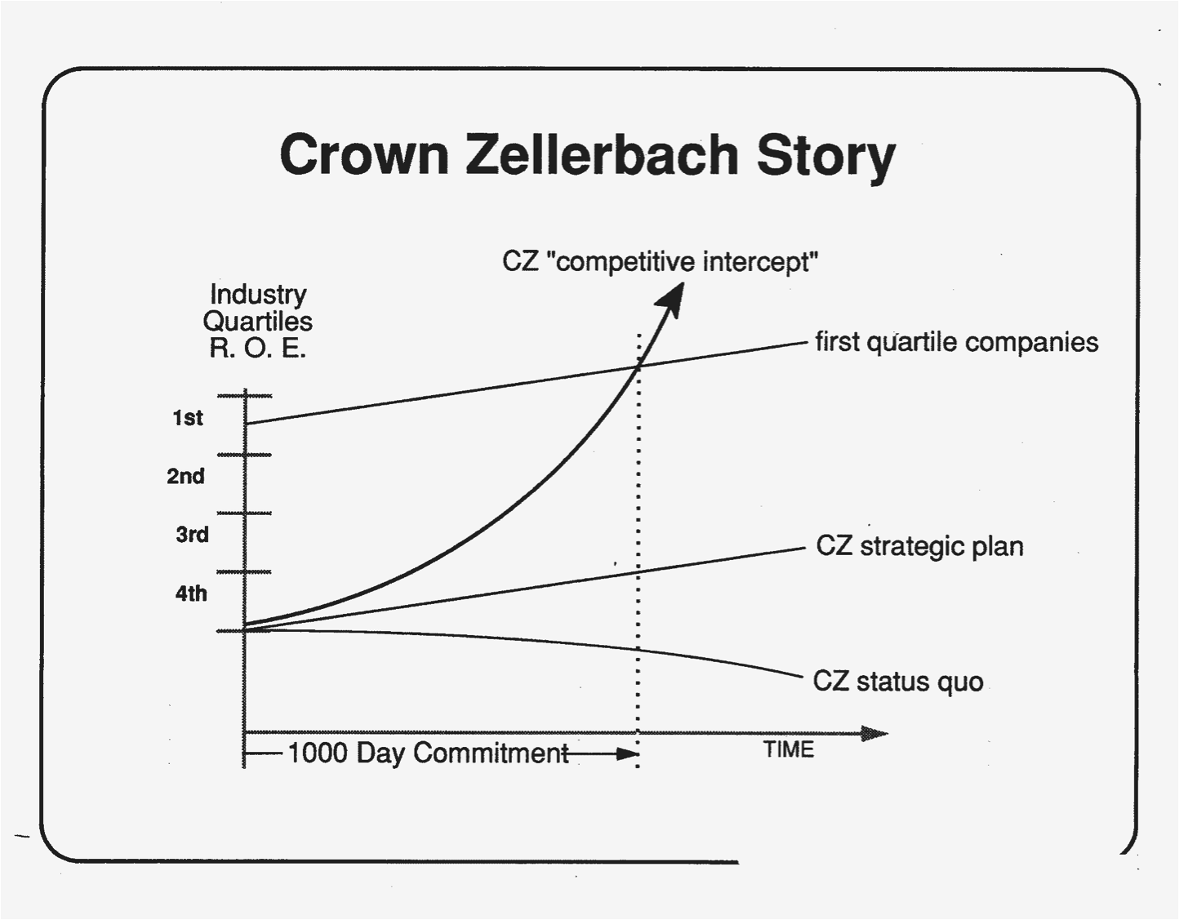
Corporate Turnaround – Crown Zellerbach Story

Slide 13
CZ Research Discovers IST Delivers 10X Results

Slide 14
Developing Thinking Capability at Crown Z

Slide 15
Developing Quality of Thinking at Crown Zellerbach

Slide 16
Research on IST Performance Improvement
P&G’s Lima plant – a 3X plant with superior quality; Bob Waterman: “Lima is the best-managed plant in the U.S.” and “…the best America has to offer.”
Clorox Kingsford Charcoal -- 3X productivity, worst to best safety, 10X quality improvement, 3X new product development, #1 or 2 in every category, 250% profitability increase, to #2;
- Work is hard, dirty, dangerous, done in remote areas; employees with limited education, some illiterate
UCLA QWL researcher, Joel Fadem: “IST is off the charts.”
Du Pont research: IST is most comprehensive, impactful
UCLA PhD Dissertation: most comprehensive is most impactful
ATD research: IST is most comprehensive, deepest, richest
Harvard Business Review – Common Disciplines underlie success in leading companies

Slide 17
IST and Technologies of Transformation Map

Slide 18
Harvard Business Review – Common Disciplines
Many leading companies use common disciplines (for planning, problem-solving, meetings, project management, etc.)
This practice brings a level of professionalism, in the way work is done, like that normally associated with professional disciplines like medicine or engineering.
The practice also:
greatly reduces the need for hierarchical and bureaucratic control; enables freedom/control that does not constrain, effective delegation
Enables effective and efficient teamwork
Enhances problem-solving
Enables conflict resolution
Helps overcome, take advantage of cultural differences
Speeds development for succession
Provides the foundational thinking for creativity

Slide 19
Research on High Performance Organizations
Leading Researchers Endorse IST Methods of Organization Development and Performance Improvement
Jim Collins: Built to Last, Good to Great, Great by Choice, How the Mighty Fall – having and preserving a core ideology, having a passion for progress; organization & culture designed to last, servant leadership, disciplined people, disciplined thinking, disciplined action
Rosabeth Moss Kanter: The Change Masters: Innovation and Entrepreneurship in the American Corporation, World Class – servant leadership, employee involvement, empowerment, innovation, change
Peter Vaill: Learning as a Way of Being: Strategies for Survival in a World of Permanent White Water – learning to adapt to & drive change
Jim Stengel: Grow – explicit brand ideal/higher purpose, building culture around this, communicating this, innovating to provide this, measuring progress against this

Slide 20
Research on Organizations of the Future
IST Users are Models of the Organization of the Future
Rosabeth Moss Kanter, Ernest R Arbuckle Professor, Harvard Business School, Supercorp: How Vanguard Companies Create Innovation, Profits, Growth and Social Good, 2009 (features P&G)
WSJ Review: “Supercorp is a remarkable look at the business of the future and the management skills required to get there.”
Rebecca Henderson, John Heinz Professor of Environmental Management, Harvard Business School, Foreword, The Responsible Business 2011 (Features P&G)
“In this visionary and hugely exciting book, path breaking businesses share insights about transforming themselves and generating sustainable prosperity, as well as a more sustainable society. These are the organizations of the future. This path has the potential to transform our world.”

Slide 21
Application of Intentional Systems Transformation
This kind of development has been central to a few dozen very successful transformational turnarounds of businesses and corporations, including P&G, DuPont, Clorox, Colgate, Honda, Sherwin-Williams, Crown Zellerbach, Scott Paper, Imperial Chemicals, ARCO, Tektronix, AE Staley, Consolidated Diesel, DEC, HP, AT&T
Over 35,000 leaders have been trained by Network Associates, and 350,000 people by internal leaders and consultants
Some of the best results have been achieved in remote locations where some learners could not read or write

Slide 22
IST Enables Organization Evolution
Level Distinctive Design Characteristics
Regenerative Self-organizing systems: internal locus of control, extensive involvement in the business and autonomy, ongoing improvement as integral to working/performing; strategic change capability, ecosystem change, essence and planetary imperatives as strategic drivers
Universal Principle Beliefs, values and principles, Management by Principle, higher consciousness, service to all stakeholders, stewardship, valuing differences, co-creative relationships, holographic organizations, more autonomy within a coherent whole, dignity
4. High Performance Purpose, vision, reengineered infrastructure, leaders, high levels of
individual and team thinking capability, disciplined methodologies, some self-management, colla- boration, involvement, continuous learning & improvement, quality, service, contribution, spirit
Performance-Oriented Order plus results-orientation, measurable goals, professional managers, management systems, external locus of control
Bureaucratic Formal organization; hierarchy, orderly, activity-orientation, rules, procedures
1. Traditional/Startup Informal organization; gaps, chaotic, capriciousness, favoritism

Slide 23
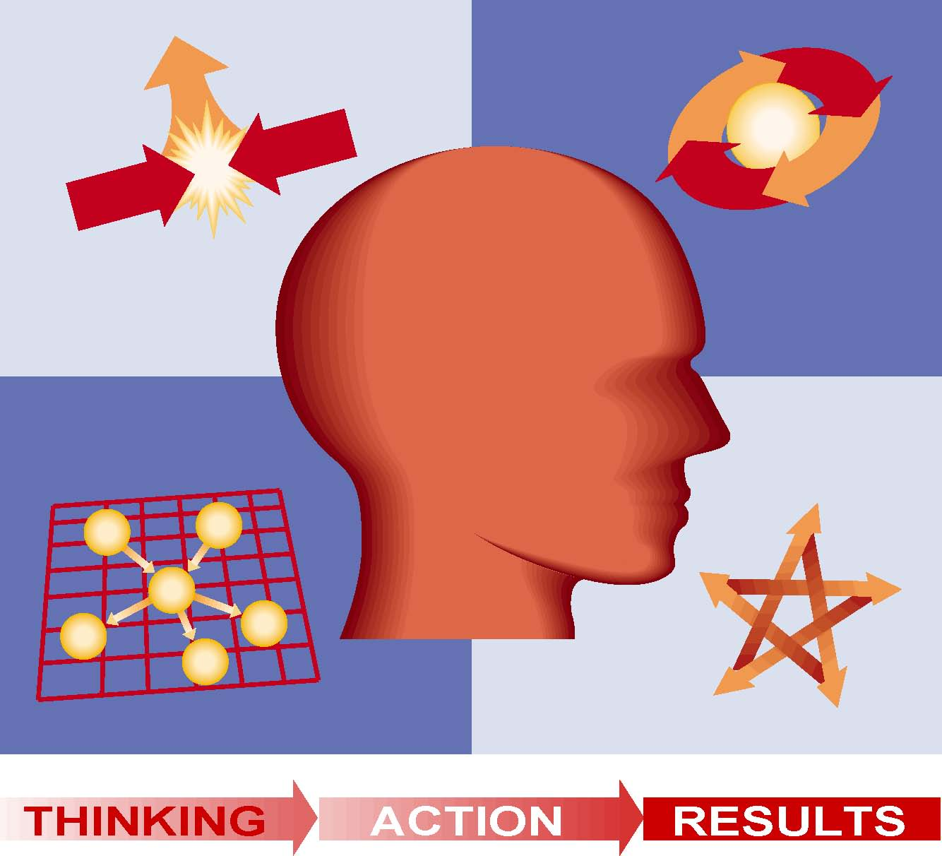
The Thinking Organization Workshop Series High-Leverage Tools for High Performance

Slide 24
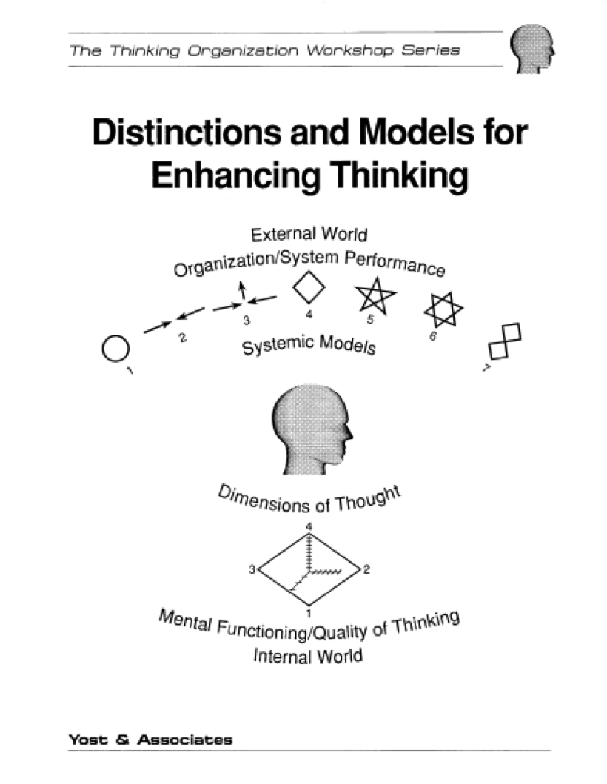
A Model of The Curriculum

Slide 25
Meta Objectives: Thinking, Interaction, Learning
Learned by developing process skills applied to real issues:
Critical thinking -- with more discipline, precision and logic more able to effectively test your own and others’ thinking
Conscious, complete, creative thinking -- to be a better planner, problem-solver, conflict manager and innovator
Independent and stronger thinking -- needing less direction, less likely to give up
Systems thinking – dealing more effectively with complexity
Self-management – to think and act more in chosen ways, e.g.: composed, focused, upbeat, courageous, receptive
Interaction skills – to more effectively build mutual understanding, relationships, alignment and unity of effort
Learning – to be more proactive, independent, creative; engaging, inquiring, testing ideas; continuous learning and improvement; reflecting, experimental-minded, building on what works.

Slide 26
The Series – Part I - Teaming
Essential Team Member Skills/Common Disciplines
Planning and executing tasks, and continuously improving task performance
Defining roles, relationships, expectations, accountabilities, follow-up mechanisms in your role networks
Effective meetings (task performance, build capability and build relationships)
Valuing and reconciling differences/conflict resolution
Building thoughts/integrating different perspectives in groups
Problem-solving and decision-making (technical/functional)
Skillful interaction (communication, listening, feedback and self-disclosure)
Commitment-based communication for forwarding the action
Self-Management (principle; will; mental state/awareness/composure)
Assertion
Relationship-building
Influencing others

Slide 27
The Series – Part II – Leadership
Planning
Interpreting reality to create meaning and significance, and continuously improving on that reality through problem-solving (complex organization problem-solving and human performance problem-solving)
Creating a Context of Governing Ideas (Purpose, Vision, Values, Beliefs, Principles, Goals, Strategies, Tactics, Action Plans, Audit, Evaluation) to realize an ideal future
Breakthrough thinking and planning
Strategic Thinking and Planning
Leading
Developing capability in self and others, coaching, empowering
Engaging and Developing Thinking/Influence (Guiding inquiry and providing new thinking methods/processes, e.g, problem-solving) versus telling and selling
Leading systemic change; Building understanding, alignment and commitment to change
Team Building

Slide 28
The Series – Part II – Leadership (cont.)
Learning and Improving Performance
Regulating performance and learning from experience (individual and organizational)
Linking
Linking your organization to others (representing, aligning, barrier reduction, resource acquisition, etc.)
Designing High Performance Organizations
Architecture: Governing Ideas, Infrastructure, Capability
Process Improvement
Basic Leadership Theory & Practice
Leader assessment, development, traits
power, influence, motivation
Business Acumen
P&L, Balance Sheets
Margins, Cash Flow

Slide 29
Potential Add-On – Consulting Skills
Coaching others in the use of teaming and leadership skills
Designing developmental events and meetings
Intervening in developmental events in ways that add value
Enabling systemic change in organizations
Engaging in continuous learning processes that enable evolution to higher levels of consciousness, will and skill
Self-Empowerment (defining your own purpose, vision, values, principles and goals and enrolling or aligning with others)
Modeling the new culture
Following up on commitments to learn and change (initiating productive change, constructively restraining counterproductive change, and reconciling restraints to productive change)
Note: This course is not part of the basic series. It can be offered to clients who have demonstrated sufficient commitment to warrant building internal consulting support to further their development efforts.

Slide 30
The How – Elements of Significant Learning
Significant Learning: a fundamental, lasting change in thinking, behavior and capability; personal transformation.
Essential Elements of Significant Learning*
For significant learning, organization change and performance improvement to occur, the learning process needs to have optimal levels of:
Intensity – 2 day events
Frequency - every 4-6 weeks
Duration - series of events -- 6,8 -- ideally, ongoing
Development of the whole person -- ability, will and mental state
Application on the job – action learning events and ongoing application to the job
Coaching support – from external consultants and ongoing from internal consultants
Leadership support – before, during and after events and processes
Learning methodology – Socratic, self-discovery
* James V. Clark, Harvard Interdisciplinary Study, and 3 decades of leading edge consulting

Slide 31
Leadership Development Research
Four Major Leadership Development Approaches & Aims
Feedback – observations from co-workers, experts
Conceptual Learning -- re effective leadership
Skill Building -- re leadership processes
Personal Growth – core values, risk-taking, self-empowerment, teaming
All four have necessary aims, and some impact in workshop settings, but neither is sufficient for lasting change in capability*. They are all missing Essential Elements of Significant Learning, e.g.:
Frequency & Duration
Application on the job
Leadership support
Development of the whole person: ability, will and mental state
Learning methodology – Socratic, self-discovery
TTOS addresses all Aims, Essential Elements, adds Thinking Capability
* Jay Conger, Learning to Lead

Slide 32
The How – Criteria for Successful Series
Natural work teams
- People who work together learn together
- 6-9 people/team
Up-front assessment
- Business situation – issues and opportunities
- Organization condition to address situation
Up-front definition of highest aspirations
- Vivid depiction of Ideal Vision
- Restraints, underlying limiting beliefs, empowering beliefs
- Organization condition to realize Ideal Vision
Leadership commitment to undertake this process to make dramatic improvements and realize Ideal Vision

Slide 33
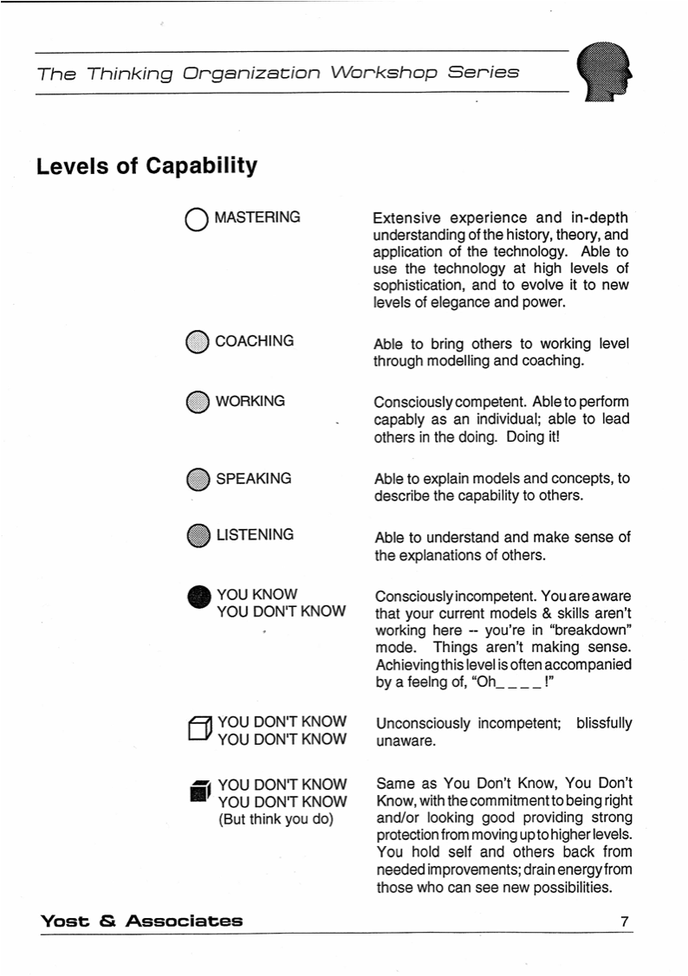
The How – Targeted Levels of Capability

Slide 34
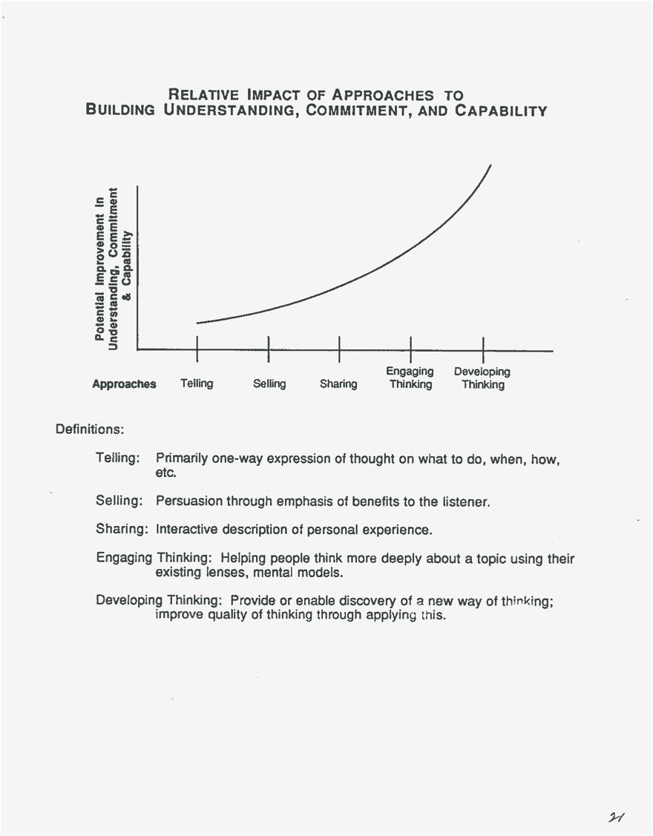
The How – Engaging & Developing Thinking

Slide 35
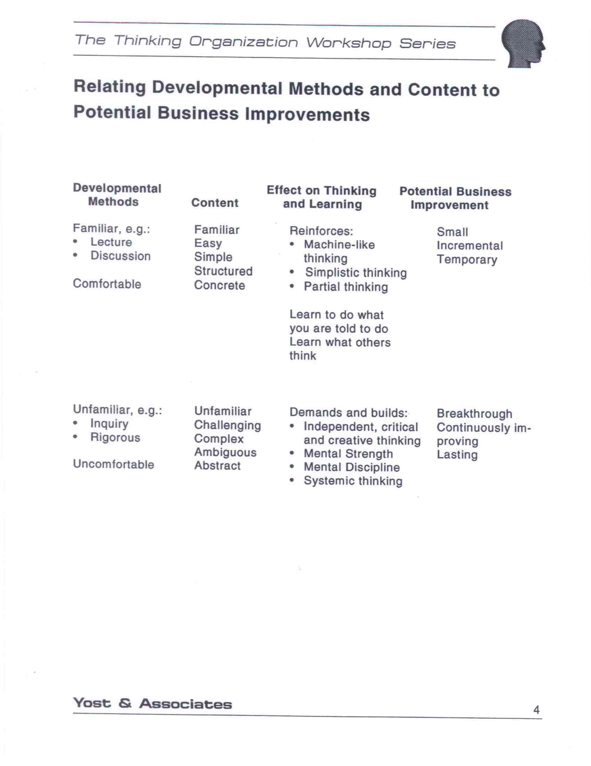
The How – Challenging Developmental Methods

Slide 36
The One Year Series is Cyclical
First Workshop -- Group of leadership teams
1. Some organizational technology introduced -- new distinctions/important variables, theory, a model, and/or a thinking framework. Assignment is given.
(Input is minimized to encourage and enable self-discovery, independent thinking, development of mental strength/will and mental discipline.)
2. Team breakout sessions -- teams each choose a real issue to work on, and apply the technology to it, for a few hours, with Socratic coaching
(Input is minimized to encourage and enable self-discovery, independent thinking, development of mental strength/will and mental discipline.)
3. Back in whole group, each team shares -- their experience, thinking, conclusions, learning, with Socratic coaching and interaction
(accelerates learning, helps maintain will)
This pattern repeats throughout the workshop -- 4 times in 2 days
4. Teams apply what they learned back on the job – with coaching
Second Workshop -- in 6 weeks – new material, iterative learning

Slide 37
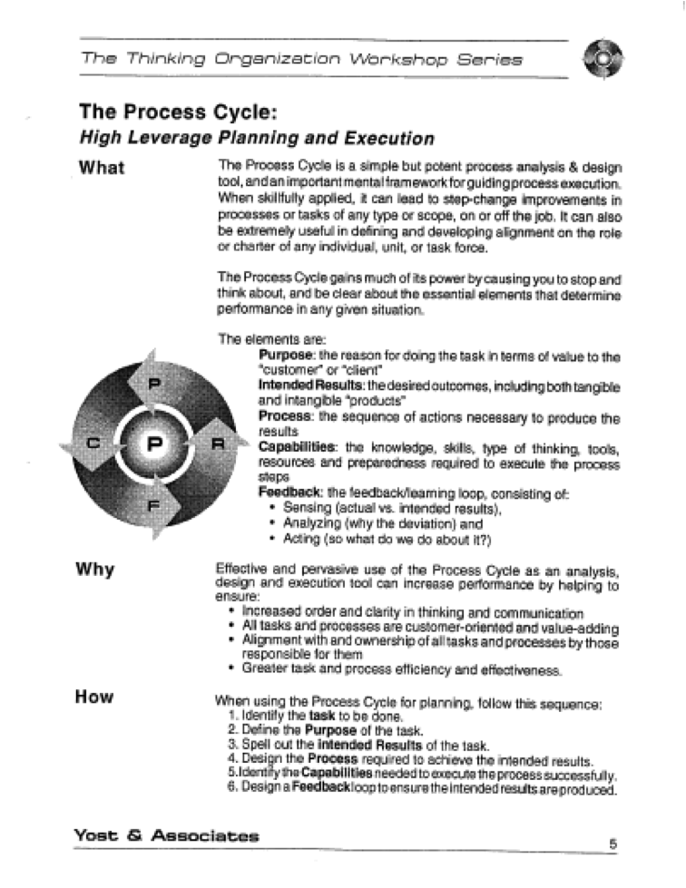
Sample Thinking Tool -- Process Cycle

Slide 38
Process Cycle – Intended and Typical Effects
Looks like a simple tool, but is really an elegant thinking framework, including all essentials for success, and no inessentials
Begins to require making important distinctions – why, what result, how, capability and preparedness required, how progress will be measured
Begins to bring consciousness, order, completeness, clarity, precision
Begins realization of deficiencies in thinking and interaction
Begins the use of Common Disciplines – rigorous approaches used by all team members that can bring professionalism to team work
Used immediately to improve planning and execution on real tasks
Used iteratively on all subsequent action learning tasks; has onion-peeling-like properties – the more you use it the more you learn about it

Slide 39
Top 10 Reasons to Invest in the Series
TTOS uniquely focuses on thinking capability
TTOS uniquely meets the requirements for significant learning
TTOS uniquely integrates all 4 of the methods employed by the 4 major leadership development processes, which, alone, are insufficient for lasting change.
TTOS processes have been core to dozens of successful corporate transformations at leading corporations, including P&G, Clorox, Colgate, Exxon, Imperial Chemicals, Digital Equipment, HP, Crown Zellerbach, Scott Paper, Consolidated Diesel, Sherwin-Williams, and Tektronix. Their results have generally been kept confidential as a competitive advantage, though a few descriptions have been published.
The pioneers of corporate social responsibility, and probably the most responsible businesses ever, in terms of impact on all stakeholders, used these processes (e.g., P&G and Clorox).

Slide 40
Top 10 Reasons to Invest in the Series (cont.)
Many independent studies found these processes enabled performance improvements of 10X other methods.
An ASTD-sponsored researcher concluded TTOS is drawn from "...the most comprehensive, deepest, richest body of technology for supporting large systems change work…“
Crown Zellerbach used these processes to implement what may be the most intensive, comprehensive and successful corporate transformational turnaround ever.
An OD Director at HP said that these materials “…introduced HP to a new way of thinking, teaming and leading, made up of profound… concepts, processes and tools. We applied them… with great success. These are the most useful methods and materials I have found…”
6 out of 34 participating Director-level and above managers in the Clorox Kingsford effort went on to become CEOs of Fortune 500 co.

Slide 41
Appendix

Slide 42
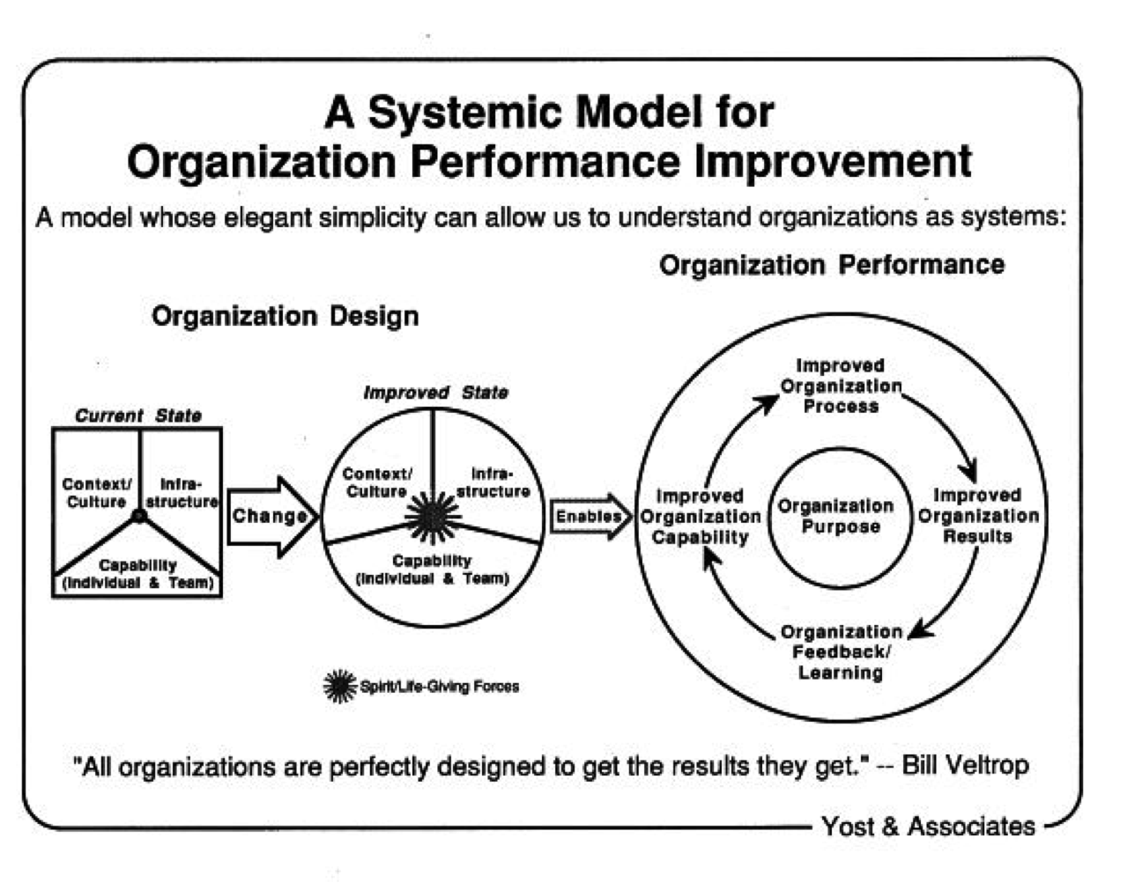
Capability Development and Systemic Change

Slide 43
Organization Change Strategy that Works

Slide 44
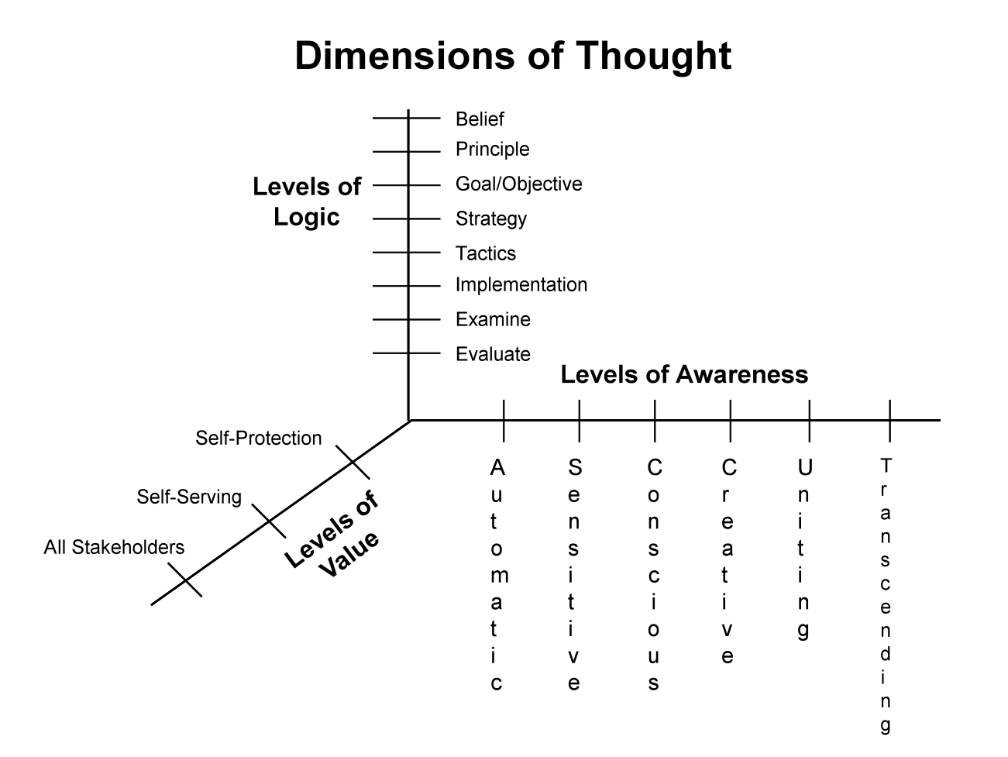
Improving Quality of Thinking in our Internal World

Slide 45
Scope of Consciousness – DoT Out of Awareness and Control vs. Self-Management of DoT

Slide 46
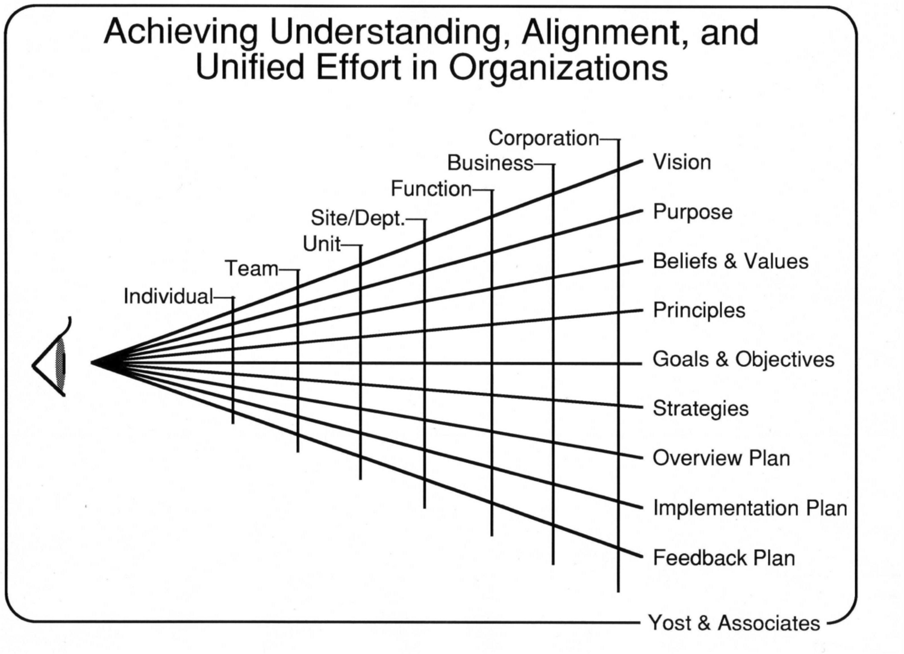
Application of DoT: Unifying Effort in Organizations

Slide 47
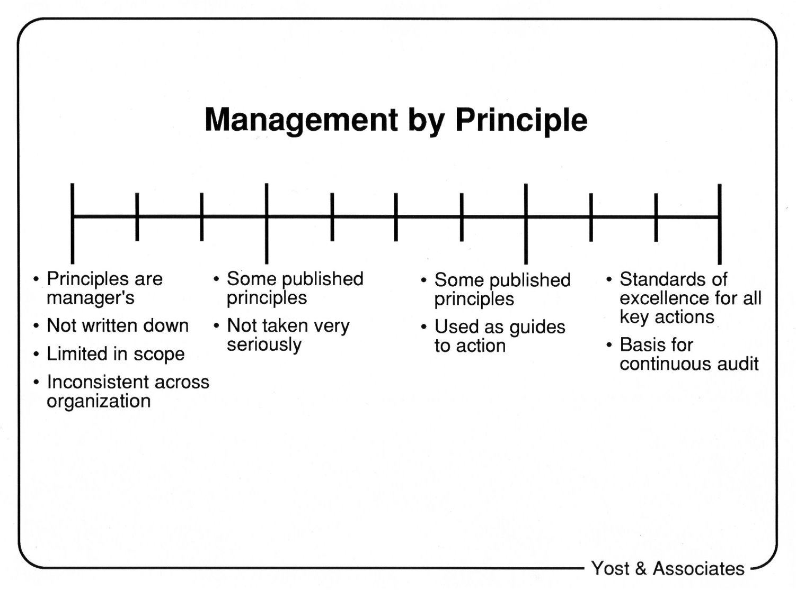
Application of DoT: Management by Principle

Slide 48
Application: Levels of Value /Modes of Behavior
Self-Protection/Reactive
Self-Serving/Ego
All Stakeholders/Purposeful

Slide 49
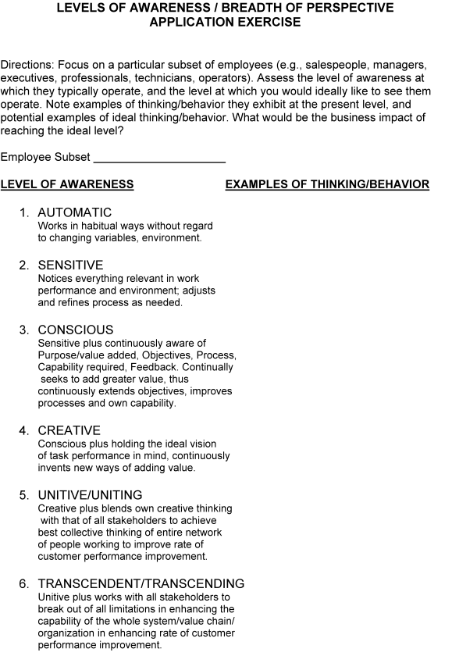
Application of DoT: Levels of Awareness

Slide 50
Levels of Awareness Example – Admin Assistant
Automatic – Does what told; types letter mechanically, without awareness of its content
Sensitive – listens carefully to manager, responds appropriately; aware of content, format, spelling, punctuation; corrects obvious errors
Conscious – Same as Sensitive Plus: aware of purpose, intended results, works to ensure letter produced matches these; uses appropriate knowledge, information, tools
Creative – Same as Conscious plus: creates draft for manager approval as requested
Unitive – Same as Creative plus: sees role as part of a communication network; works to ensure all stakeholder needs are met
Transcendent – Same as Unitive plus: anticipates need for a new type of communication to forward the action; sees whole, vision, direction, principles, goals, strategy; initiates letter to all stakeholders in manager’s absence

Slide 51
Comparing Management Paradigms
COMMAND & CONTROL/BEHAVIOR MANAGEMENT PARADIGM:
Based on Theory X beliefs (people are irresponsible and apathetic) , and behavioral (carrot & stick) psychology. Typically coupled with a machine model of organizations and analytic/reductive thinking.
Provides generic standards for BEHAVIOR
Has processes to arrest deviation from the standards, including:
policies, procedures and rules
behavioral training, coaching, mentoring and modification
incentives
360 degree behavioral feedback
performance appraisals and ranking
counseling, disciplining and firing
These processes are aimed at CONTROL and compliance
Focus is on what we see, or surface characteristics of people, and behaviors

Slide 52
Comparing Management Paradigms
COMMAND & CONTROL/BEHAVIOR MANAGEMENT PARADIGM:
Theory X is a self-fulfilling prophesy and tends to evoke the lowest nature of people – self-interested, fearful, passive, need to be told, conforming, dependent, with very low levels of thinking
Incentive cultures tend to be divisive, create self-interest, winners and losers, engender conformity, gaming the system, suppress independent thinking, unique contributions and the intrinsic motivation that comes from these.
The net result is an EXTERNAL LOCUS OF CONTROL (belief that others control my level of performance -- someone else tells me what to do, how to do it, whether I’m doing it all right, rewards doing it right) – and feeling powerless, making excuses, lacking motivation or accountability.
This is a machine model of reality, about approaching perfection relative to a standard of behavior (an asymptotic model with diminishing returns)
This approach worked satisfactorily in a stable environment.

Slide 53
Comparing Management Paradigms
STRATEGIC SELF-MANAGEMENT PARADIGM
Based on the following beliefs:
Today’s turbulent business environment requires continuous innovation, improvement
and agility; people cannot wait to be told what to do – they must act with responsible
autonomy.
People at all levels and can be committed, responsible, trustworthy drivers of needed
change, and can be equipped to understand the business, the business situation,
where things are going and to be capable of determining what’s necessary.
The best results are achieved when there is a common understanding, alignment and
commitment to organization purpose, goals and strategies, and people throughout the
organization are empowered to decide what is best for all stakeholders.
These are typically coupled with the belief that Organizations are living systems,
complex, indivisible, interconnected wholes, whose performance depends on the
interaction of their parts, and whose viability depends on the mutual satisfaction of
stakeholder needs. Systemic/holistic thinking is what is needed to support this approach.

Slide 54
Comparing Management Paradigms (continued)
STRATEGIC SELF-MANAGEMENT PARADIGM
Has generic standards for THINKING processes
Has processes to create a higher order of thinking and action:
- Create a comprehensive context of governing ideas to guide everyone
- Provide everyone with understanding of the business, the value chain, the
science underlying the work, the customer’s values and vision and
business performance information,
- Develop higher order thinking and interaction capabilities in everyone
These processes are aimed at CONSCIOUSNESS, COMMITMENT,
ALIGNMENT, UNITY AND SELF-CONTROL
The focus is on people’s essence/who they can be, and their thinking about
work
They result in uniqueness in people, proactiveness, and in very high levels of
thinking (conscious, creative, uniting, transcending)

Slide 55
Comparing Management Paradigms (continued)
STRATEGIC SELF-MANAGEMENT PARADIGM
This is the self-fulfilling Theory Y, resulting in an INTERNAL LOCUS OF
CONTROL (belief that I am in charge – and in the best position to manage my
own affairs -- to decide what is best for the customer and enterprise, and assess
its effectiveness for continuous improvement)
This results in empowerment, motivation, persistence and accountability.
This is a generative model of reality, about limitless improvement against evolving
stakeholder needs.
This approach is what is required in a turbulent business environment.

Slide 56
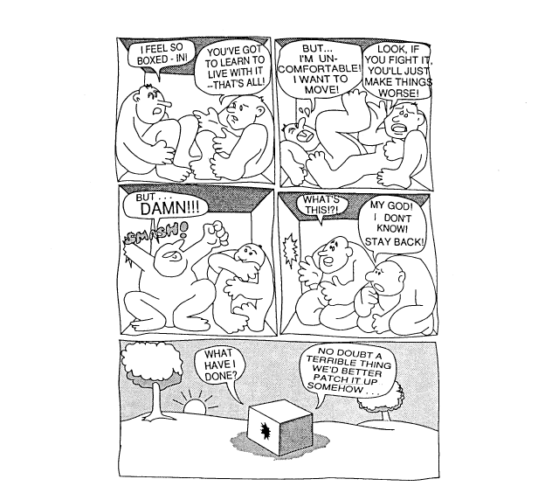
Breaking Out of the Box

Slide 57
Proposal Options for Engaging
1 Leadership Team, six 2-day workshops, 1 consultant @ $2500/day
2 days prework
6 days workshop design – tailoring to unique client needs
12 days workshop
6 days coaching
26 days = $65 K
2 Leadership Teams, six 2-day workshops, 2 consultants
2 days prework
6 days workshop design – tailoring to unique client needs
24 days workshop
9 days coaching
41 days = $102.5 K
3 Leadership Teams, six 2-day workshops, 3 consultants
2 days prework
6 days workshop design – tailoring to unique client needs
36 days workshop
12 days coaching
56 days = $140 K
Internal Consultant development
Additional 6 days = $15 K

